Slide 1
08 | Rewind
James Chambers | @CanadianJames
Simon Timms | @stimms

Slide 2
Module Overview
What we have done

Slide 3
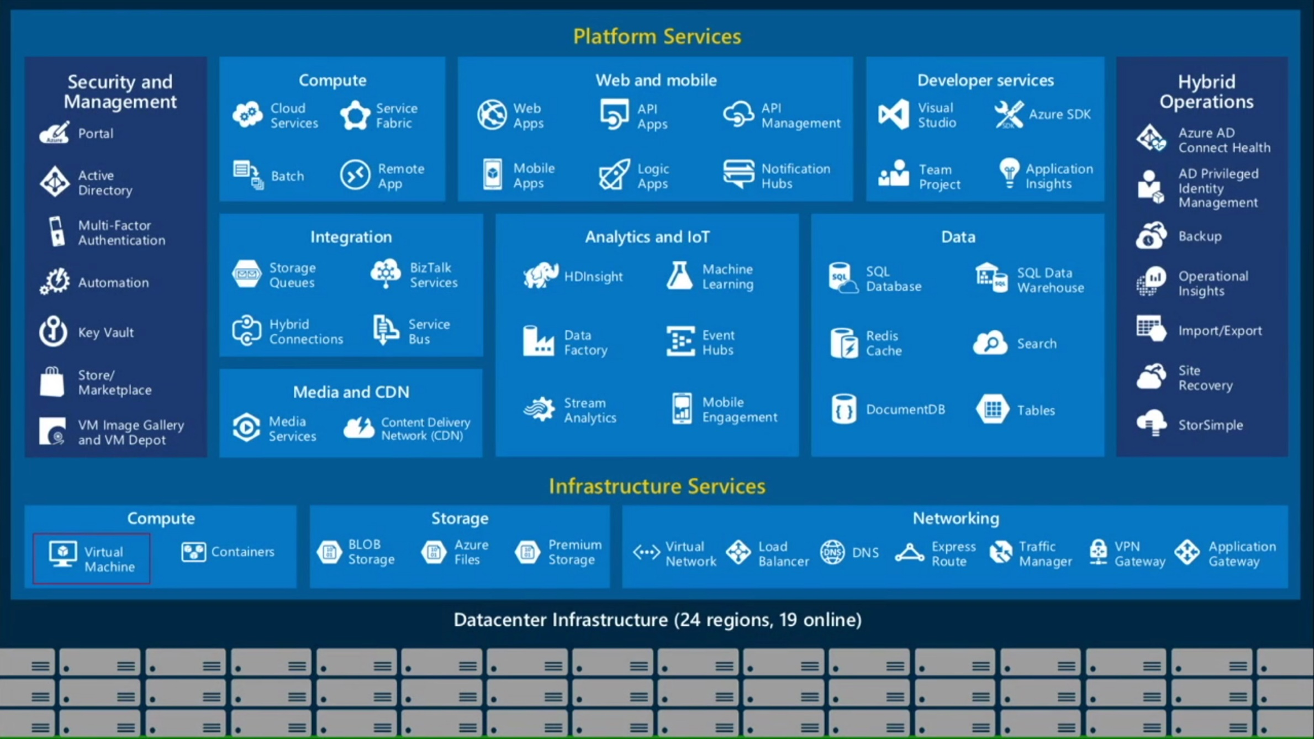
Bits of Azure

Slide 4
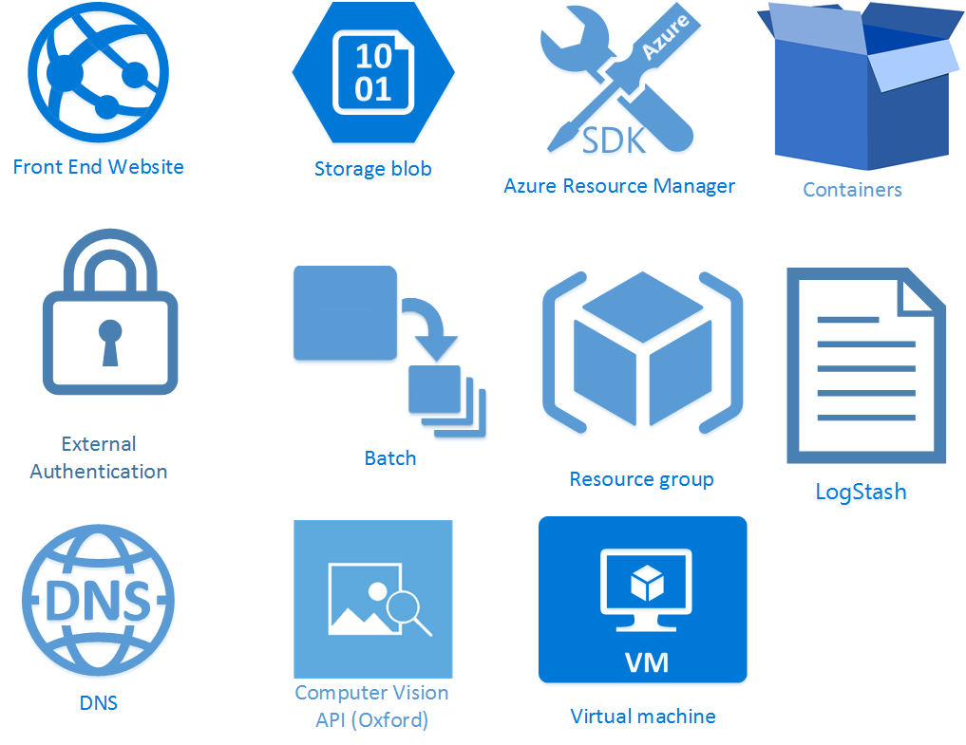

Slide 5
Questions? Drop us a line
@stimms
@canadianjames

